Slide 1
Unit Impulse and Sampling Theorem
Introduce the concept of sampling using a mathematical function called the Dirac-δ function.
This leads to the Nyquist sampling theorem which stipulates the minimum sampling frequency required in order to reconstruct the continuous time signal from its samples.
Let x(t) be a continuous time signal and let T_{s}>0 be a fixed number. From x(t), we can derive the discrete signal :
T_{s} is called the sampling period. The sampling frequency, f_{s} in Hertz is
defined as Hz or radians/sec. The time t=nT_{s}
is called the sample instant. The process of extracting x(nT_{s}) is called sampling.

Slide 2
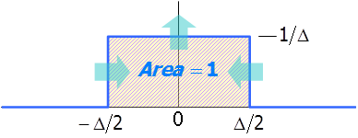
Model of the Sampled Signal and its Fourier Transform
The mathematical process of sampling requires a function called the Dirac-δ function or the unit impulse function in continuous time.
The Dirac-δ function is defined by :
with
You may view the unit impulse as a limiting case of a rectangle pulse which has a unit area that is independent of its pulse width:

Slide 3
Properties of the Dirac-δ function
Property 1 : Symmetry
Property 2 : Sifting
Property 3 : White Spectrum
This property implies that the Dirac-δ function has a spectrum that extends over all frequencies with an amplitude spectrum of 1.

Slide 4
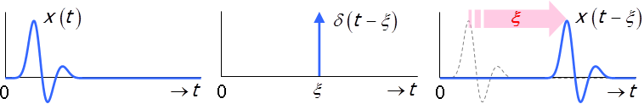
Property 4 : Replication
* denotes convolution

Slide 5
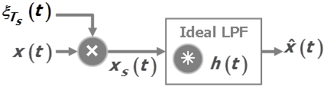
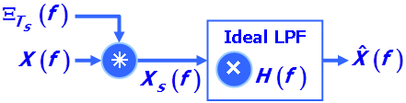
Continuous Time Sampling Process
Recall from 3-11 the Comb function :
Denoting the sampled signal as x_{s}(t), the continuous time sampling process is a multiplication process between x(t) and ξ_{Ts}(t) :
The operator * denotes convolution

Slide 6
Sampling is necessary for digital implementation. In the PCM communications system, the audio signal was sampled, coded and then transmitted. At the receiver, the digital signal was decoded and the audio signal recovered through low pass filtering (LPF).
The block diagrams above show the reconstruction process in time and frequency domains.
Under the most ideal situation where there is no noise in the system, what is the required sampling frequency in order for ?
The question we ask is what is the minimum f_{s} for which the reconstructed or recovered signal after LPF is perfect?

Slide 7
Sampling Process : Assume sampling frequency
f_{m} denotes the highest frequency component in x(t).
→ t
0
1

Time
Domain
Sampling = Multiplication in time domain
0
→ t
0
→ t

Slide 8
Based on the multiplication property in slide 3-15, multiplication in time domain is a convolution in frequency domain :
Therefore,
From slide 3-27/28,

Slide 9
Therefore,
Apply replication property of the Dirac delta function
This tells us that, in frequency domain, the sampling process produces replicas of the original spectrum of x(t), each copy being centered around kf_{s}, k=…-3,-2,-1,0,1,2,3,…
This process is shown diagrammatically in the next slide.

Slide 10
In frequency domain :
Original spectrum before sampling
0
→ f
Convolution in frequency domain with the Comb function produces replicas in frequency domain
↓
0
→ f
Spectrum after sampling
0
→ f
The result of the sampling process is that the spectrum of the sampled signal extends all the way to infinity.

Slide 11
In the reconstruction, apply low pass filter to X_{s}(f) :
0
→ f

Ideal Low Pass Filter
K
0
→ f
Recovered signal
0
→ f
Question : Under what conditions of f_{s} can reconstruction be achieved perfectly?

Slide 12
Consider what happens when where f_{m} is the
highest frequency component of x(t).
Spectrum of Sampled Signal when :
0
→ f
→ f
0
→ f

Slide 13
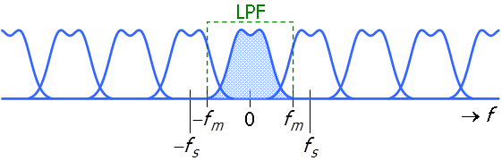
What is the consequence on signal recover?
Spectral images overlap and consequently, perfect recovery of original analog signal is not possible.
This phenomenon is called signal aliaising.
This tells us that the minimum sampling frequency is so that aliasing does not occur and consequently, signal reconstruction can be achieved.

Slide 14
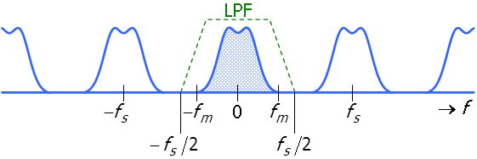
Spectral images do not overlap and gaps appear between spectral images due to oversampling ie sampling more than 2f_{m}.
Perfect reconstruction is possible.
The design of the LPF is also easier.
Conditions for perfect reconstruction :
X(t) must be bandlimited
Sampling frequency
Reconstruction LPF :

Slide 15
Self Test Problem 1
Let
Sketch

Slide 16
Self Test Problem 2
Using and , we construct
another signal
Assume , sketch the spectra of x(t), y(t) and v(t).
What happens to v(t) if ?

Slide 17
Self Test Problem 3
A bandpass signal, x(t), has a spectrum X(f) shown in the figure below.
What is the Nyquist sampling frequency for x(t)?
Can x(t) be perfectly reconstructed if the sampling frequency is 20 Hz?
Show answer graphically.
Symmetric
about
Symmetric
about
-26
-20
-14
0
14
20
26
→ f

